Slide 1
Evolution of Data Warehouse

Slide 2
What is Data Warehouse?
Data warehousing is combining data from multiple and usually varied sources into one comprehensive and easily manipulated database.
Because data warehousing creates one database in the end, the number of sources can be anything you want it to be, provided that the system can handle the volume, of course.
The final result, however, is homogeneous data, which can be more easily manipulated.

Slide 3
Data Warehouse Architecture

Slide 4
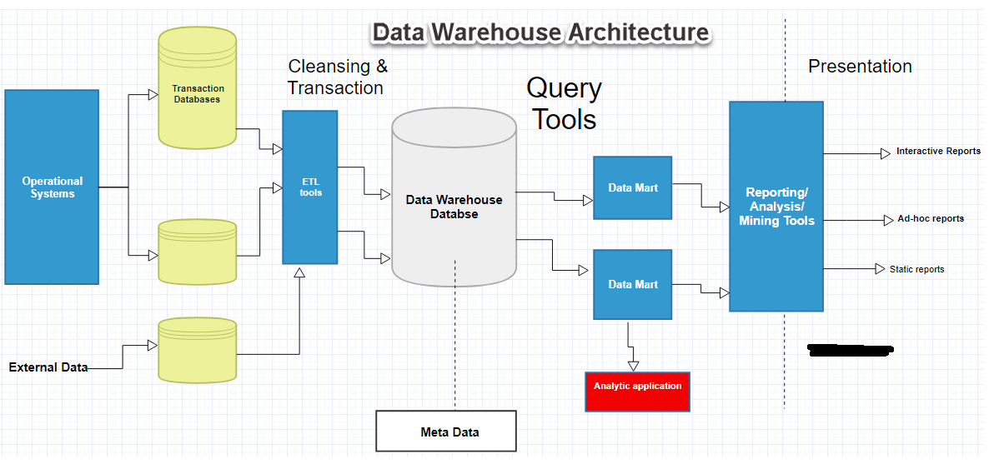

Slide 5
Data Staging
A data staging area (DSA) is a temporary storage area between the data sources and a data warehouse.
The staging area is mainly used to quickly extract data from its data sources, minimizing the impact of the sources.
After data has been loaded into the staging area, the staging area is used to combine data from multiple data sources, transformations, validations, data cleansing.

Slide 6
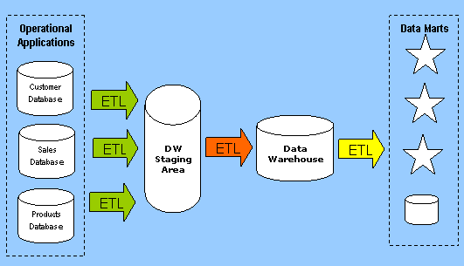
Example 1 of Data Stage

Slide 7
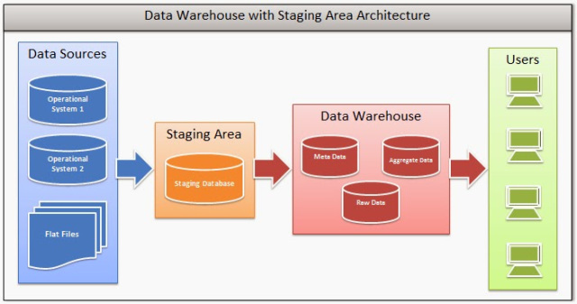
Example 2 of Data Stage

Slide 8
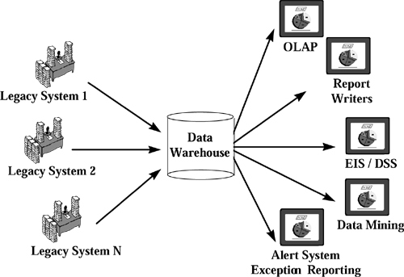
Multiple Inputs and Multiple Outputs via D/W
Notes:
EIS → Executive Information System
DSS → Decision Support System

Slide 9
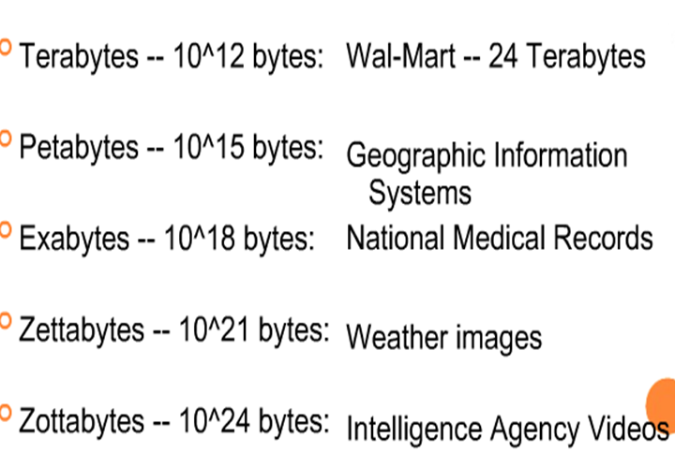
Volume of Data in a D/W

